Slide 1

Brain-Computer Interface(BCI) with ML and its Applications
Discussed BY:
Gopal Chandra Jana
(RSI2018508)
PhD Research Scholar
Department: Information Technology
IIITA

Slide 2
Outline
Over View of Human Brain
1.1 Biological Principles
1.2 Technical Principles
2. Literature Review/Survey
3. Motivation and Area of Application
3.1 Applications area of BCI
3.2 Research challenges in BCI
4. Conclusion

Slide 3
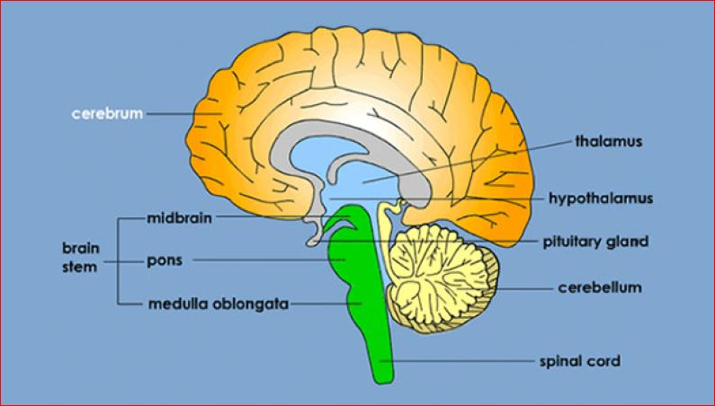
About The Human Brain and Nervous System
The brain is like a computer CPU that controls the body's functions, and the nervous system is like a network that relays messages to parts of the body [1].
Cerebrum: The largest part of the brain, the cerebrum has two hemispheres (or halves). The cerebrum controls voluntary movement, speech, intelligence, memory, emotion, and sensory processing [1].
Fig.1,[1]

Slide 4
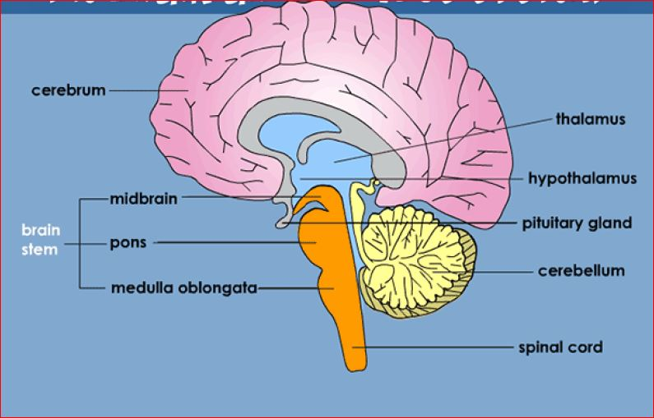
About The Human Brain and Nervous System
Brain Stem:
At the base of the brain, the brain stem connects to the spinal cord and is made up
of the midbrain, pons, and medulla oblongata [1].
Fig.2,[1]

Slide 5
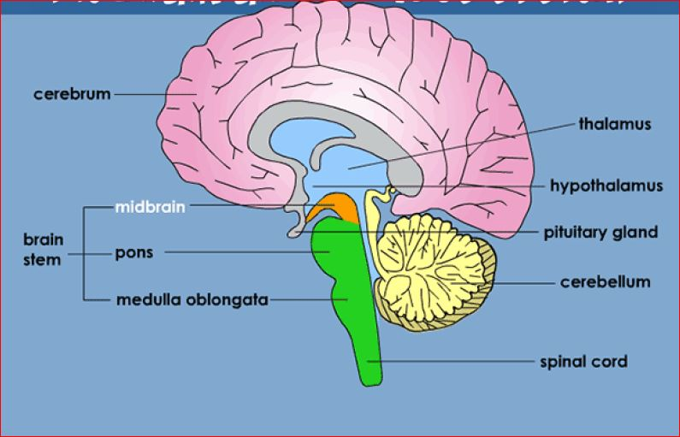
About The Human Brain and Nervous System
Midbrain:
The midbrain acts like a complex switchboard, allowing the brain to communicate with the rest of the nervous system [1].
Fig.3,[1]

Slide 6
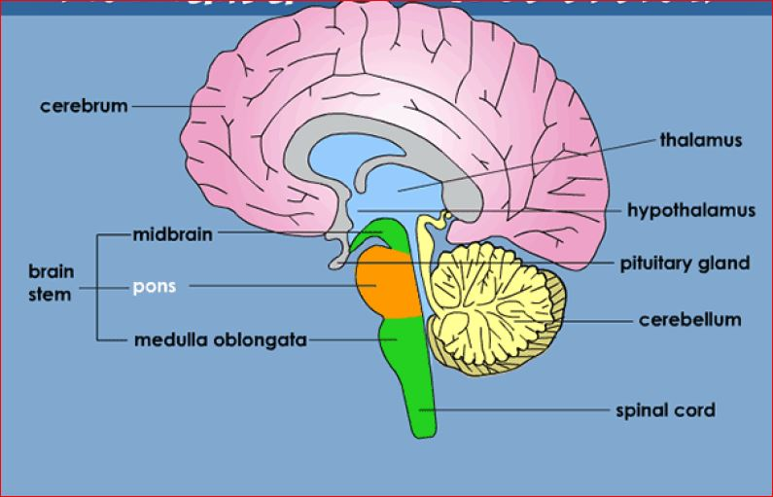
About The Human Brain and Nervous System
Pons:
The pons relay messages from the cerebrum to the cerebellum and spinal cord [1].
Fig.4,[1]

Slide 7
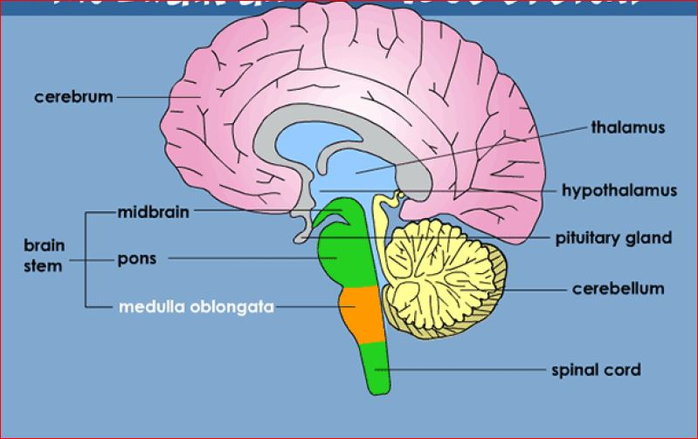
About The Human Brain and Nervous System
Medulla Oblongata:
This portion of the brain stem is located just above the spinal cord. It regulates vital functions, such as heartbeat and breathing [1].
Fig.5,[1]

Slide 8
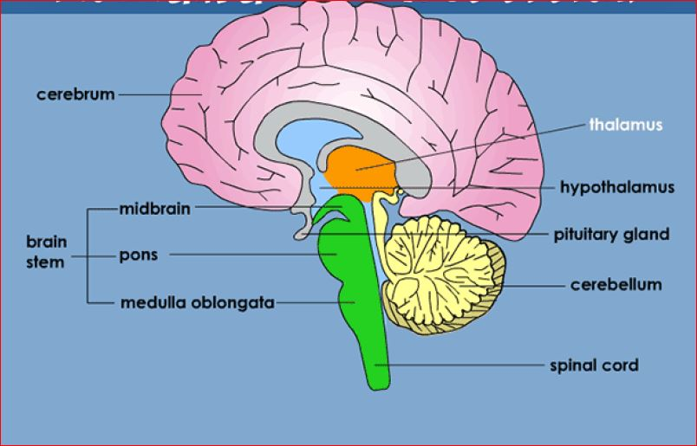
About The Human Brain and Nervous System
Thalamus:
Located in the central part of the brain, the thalamus processes and coordinates sensory messages, such as touch, received from the body [1].
Fig.6,[1]

Slide 9
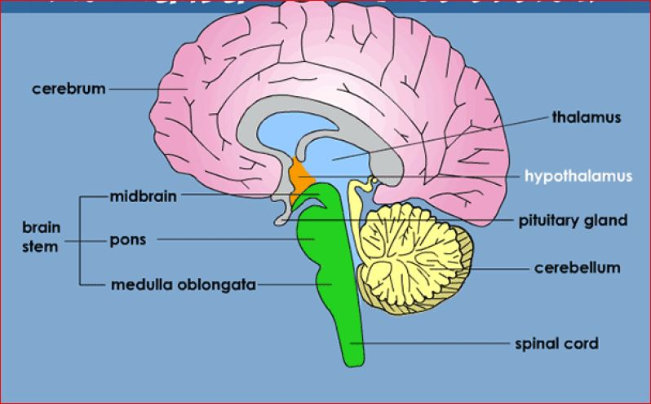
About The Human Brain and Nervous System
Hypothalamus:
The hypothalamus regulates functions like thirst, appetite, and sleep patterns. It also regulates the release of hormones from the pituitary gland [1].
Fig.7,[1]

Slide 10
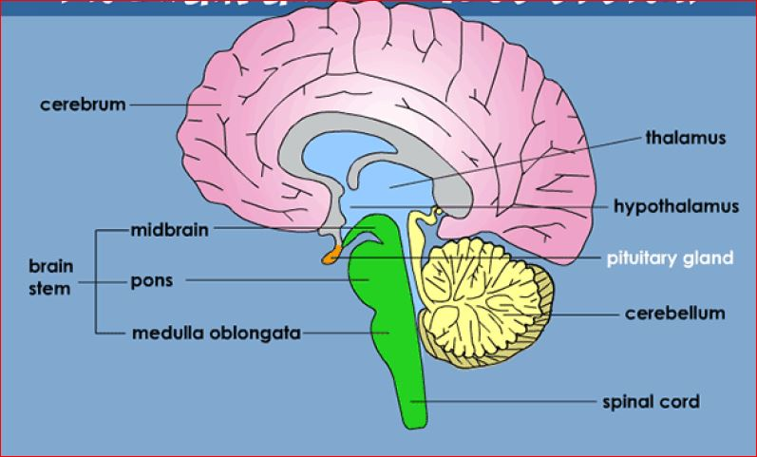
About The Human Brain and Nervous System
Pituitary Gland:
This tiny gland produces hormones involved in regulating growth, puberty,
metabolism, water and mineral balance, the body's response to stress, and more [1].
Fig.8,[1]

Slide 11
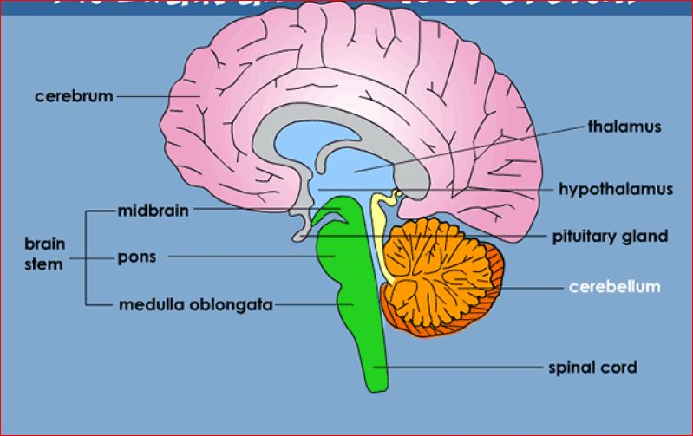
About The Human Brain and Nervous System
Cerebellum:
The cerebellum helps coordinate and fine‑tune movement and balance [1].
Fig.9,[1]

Slide 12
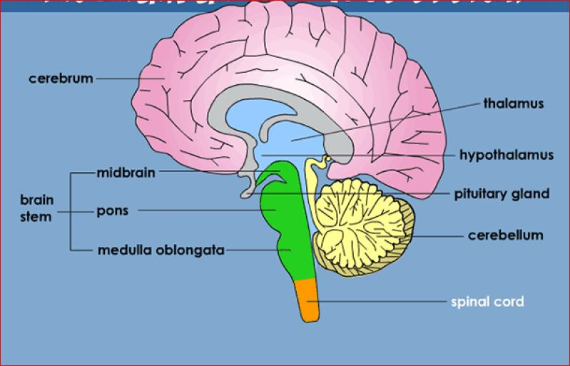
About The Human Brain and Nervous System
Spinal Cord:
This portion of the central nervous system runs down the inside of the spinal
column, connecting the brain with nerves going to the rest of the body [1].
Fig.10,[1]

Slide 13
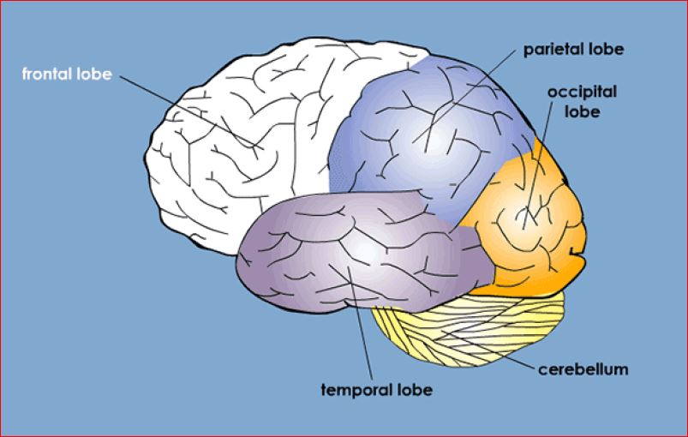
About The Human Brain Lobes
Frontal Lobe:
The frontal lobe, located behind the forehead, does much of the work of complex
thinking, like planning, imagining, making decisions, and reasoning [1].
Fig.11,[1]

Slide 14
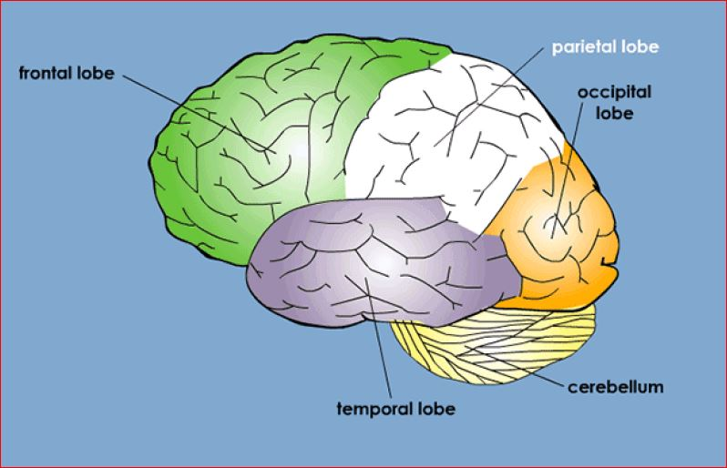
About The Human Brain Lobes
Parietal Lobe:
The parietal lobe, located behind the frontal lobe, processes messages related to
touch, taste, and temperature [1].
Fig.12,[1]

Slide 15
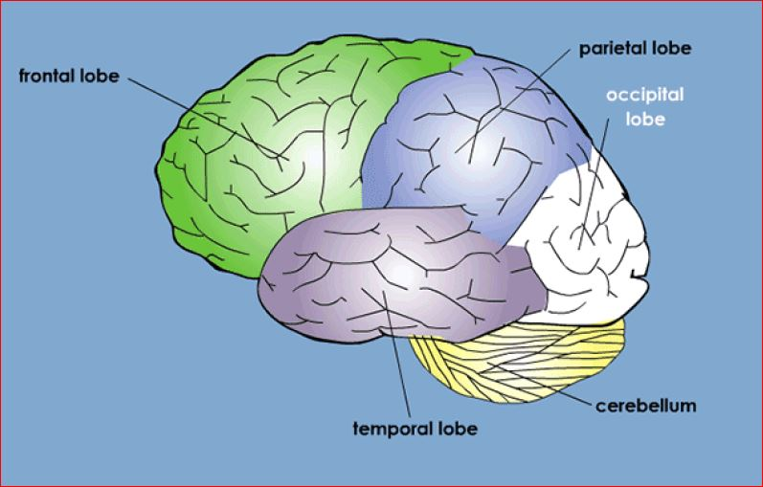
About The Human Brain Lobes
Occipital Lobe:
The occipital lobe, in the rear of the brain, processes light and other visual information from the eyes [1].
Fig.13,[1]

Slide 16
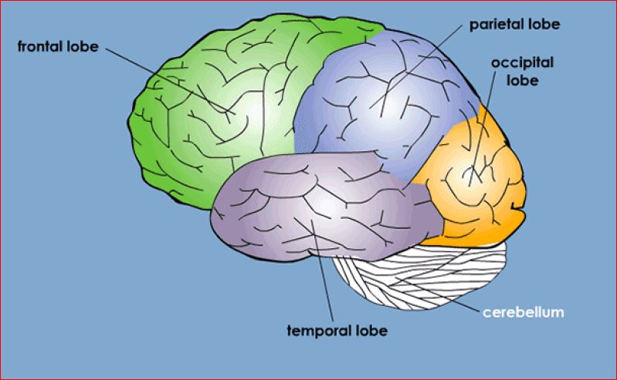
About The Human Brain Lobes
Cerebellum:
The cerebellum helps coordinate and fine‑tune movement and balance [1].
Fig.14,[1]

Slide 17
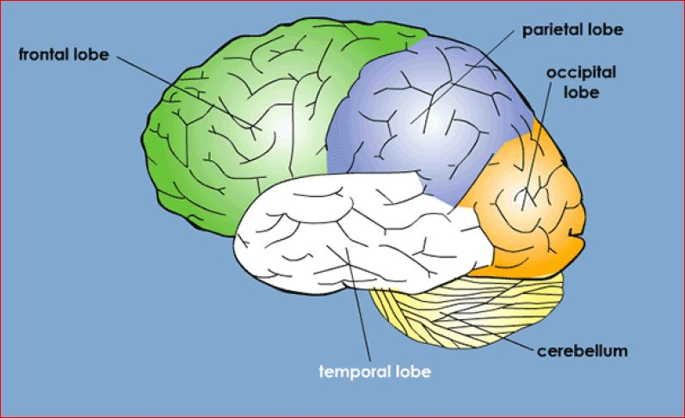
About The Human Brain Lobes
Temporal Lobe:
The temporal lobe, found near the ears, processes hearing and is involved in memory retrieval [1].
Fig.15,[1]

Slide 18
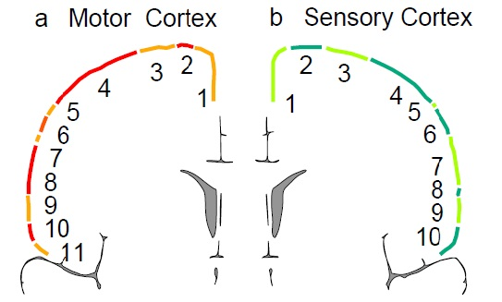
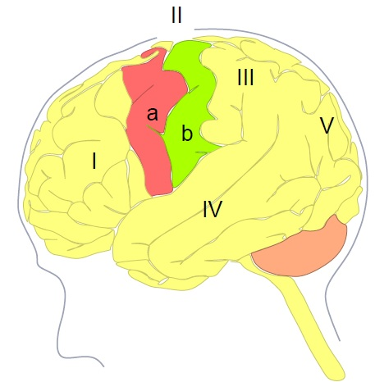
Human Brain
Biological Principles
Fig.17,[1]
Fig.16, [1]
Foot, Leg
Trunk, Head
Arm
Hand, Fingers
Eye
Face
7. Lips
8. Jaw, Teeth
9. Tongue
10. Pharynx
11. Intra-abdominal
I: Frontal Lobe (Motor/Higher order Function)
II: Fissure of Rolando (Central Sulcus)
III: Parietal Lobe ( Sensation, Motor Control)
IV: Temporal Lobe(Emotion, Hearing, Memory)
V: Occipital Lobe( Vision, Color Recognition)

Slide 19
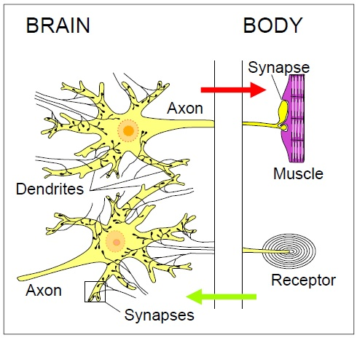
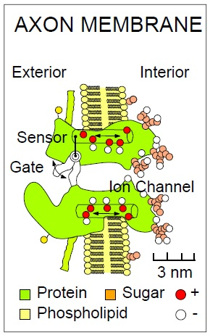
Human brain
Biological principles (Nerve, Muscle, Receptor and Bioelectricity)
Fig.19,[1]
Fig.18,[1]

Slide 20
Brain Signal
Biological Principles
Each of the brain hemispheres is segmented into four lobes with different functions.
The lobes are separated by fissures (sulcus).
The Primary Somatic Sensory Cortex (Parietal Lobe) and the Primary Motor Cortex (Temporal Lobe) are the most important regions for BCI research.
No central lobe exists, the ‘C’ letter is used for identification purposes only.
Lobe | Electrode
F | Frontal
T | Temporal
C | Central
P | Parietal
O | Occipital
Table-1, [7]

Slide 21
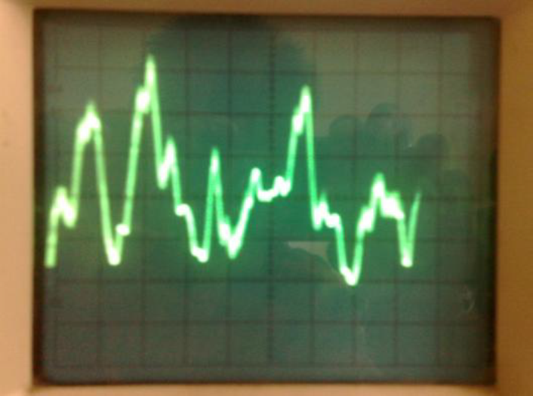
Brain Signal
Brain Signals
Electroencephalography(EEG) signals
Electrocorticography(ECoG) signals
3. Electrooculographic (EOG) signals)
Several changes occurs due to different Mental Sate, Motor Imagery task, Eye movements and Eye Blinks.
These signals are roughly less than 100 μV and 100 Hz [2].
Fig.20: EEG Signal in oscilloscope [2]

Slide 22
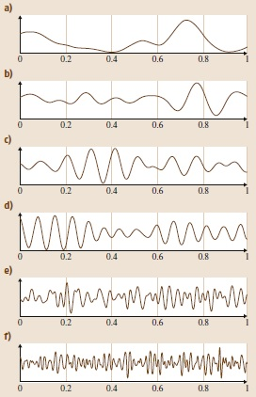
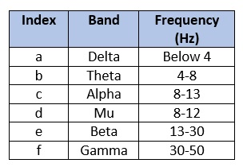
Brain Signal
Electroencephalogram(EEG) Signal
Electroencephalogram(EEG): The electroencephalogram study is a way to measure activity in our brain. Our brain is full of electrical activity [2]. Change of mental activity happened due to the electrical firing of neurons [2]. The electroencephalogram itself has several band separated by frequency mention below:
Fig. 21, [2]
Table-2, [2]

Slide 23

So, How we will Acquire or Record EEG Signals from Human Brain

Slide 24
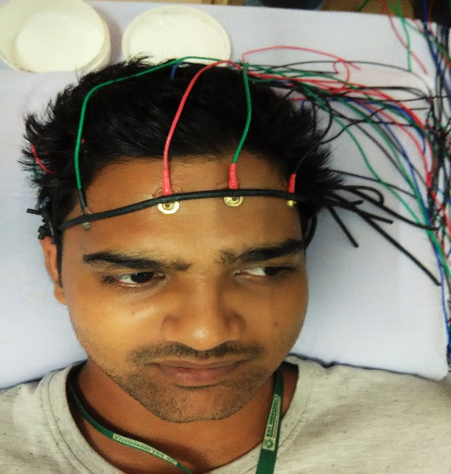
SAT
Signal Acquisition Techniques
Invasive BCI 2. Non-invasive BCI 3. Partially Invasive BCI
in Fig.22 in Fig. 23 in Fig. 24
Fig.22, [2]
Fig. 23
Fig. 24, [2]

Slide 25
So, How we will Placed Electrode on the Scalp of Human Brain
Is any Universal Process available for Electrode Placement

Slide 26

Yes
We should follow the Universal 10/20 System Process for Electrode Placement

Slide 27
Electrodes Types:
Different types of electrodes are often used in the EEG recording systems, such as:
Disposable electrodes (gel-less, and pre-gelled types);
Reusable disc electrodes (gold, silver, stainless steel , or tin);
Headbands and electrode caps
Saline-based electrodes
Needle electrodes

Slide 28
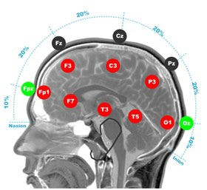
About 10/20 System:
General Introduction:
The 10/20 system or International 10/20 system is an internationally recognized method to describe the location of scalp electrodes [7].
The system is based on the relationship between the location of an electrode and the underlying area of cerebral cortex. here numbers ‘10’ and ‘20’ refer to the fact that the distances between adjacent electrodes are either 10% or 20% of the total front- back or right-left distance of the skull [7].
Each site has a letter to identify the lobe and a number to identify the hemisphere location [7]
Fig 25: placement of Electrode [7]

Slide 29
10/20 System:
No central lobe exists, the ‘C’ letter is used for identification purposes only [7].
The ‘z’ (zero) refers to an electrode placed on the mid line [7].
Even numbers (2,4,6,8) refer to electrode positions on the right hemisphere [7].
Odd numbers (1,3,5,7) refer to electrode positions on the left hemisphere [7].
Electrode | Lobe
F | Frontal
T | Temporal
C | Central *
P | Parietal
O | Occipital
Table3:Denotes Electrode local position on Scalp [7].

Slide 30
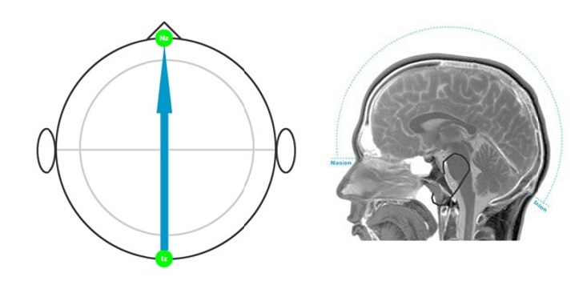
Electrode Placement Procedure:
Step 1
Take a measuring tape and use the centimeter side.
Measure over the center line of the scalp, from the Nasion (bridge of the nose) to the Inion (occipital pretu- berance). Note the total length [7].
For our example, the total length is 36 cm.
Fig. 26
Fig. 27

Slide 31
Electrode Placement Procedure:
Step 2
Measure and mark 50% of your total .This is your preliminary Cz mark.
In our example 36 cm / 2 = 18 cm.
Step 3
Measure and mark 10% up from the Nasion and 10% up from the Inion.
These are your preliminary mark of Fpz and Oz.
In our example 10% of 36 cm is 3.6 cm
Fig. 28, [7]
Fig. 29, [7]

Slide 32
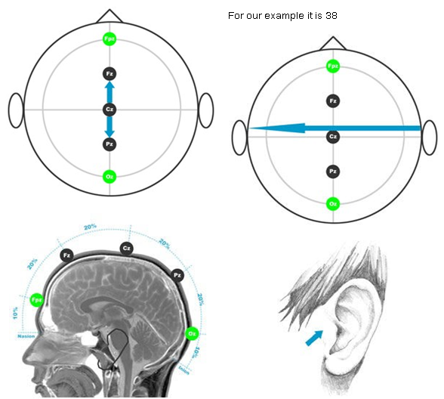
Electrode Placement Procedure:
Fig. 30, [7]
9999999999999
Step 4
Mark 20% from either the first mark of Fpz or Cz. These will be your preliminary marks of Fz and Pz.
In our example 20% of 36 cm is 7.2 cm
Step 5
Measure from preauricular point to preauricular- point. Lightly run your finger up and down just anterior to the ear; the indentation above the zygo- matic notch is easily identified. Opening the mouth slightly makes it easier to find the exact location.Note the total length.
For our example it is 38

Slide 33
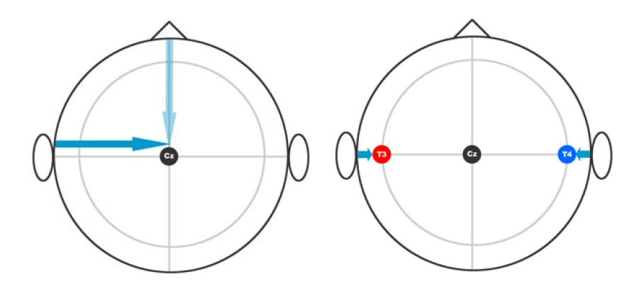
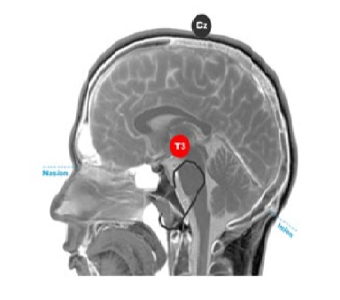
Electrode Placement Procedure:
Fig. 31 [7]

Slide 34
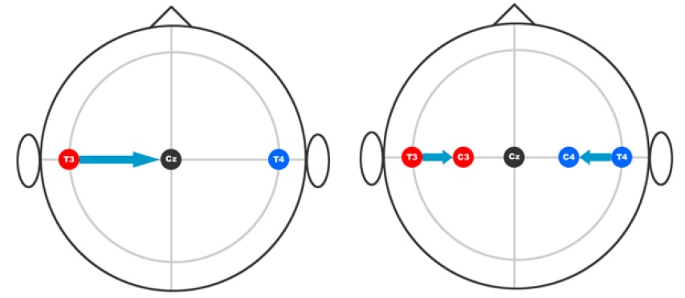
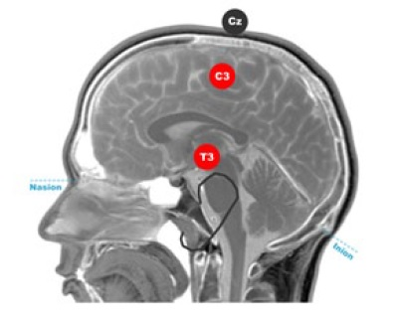
Electrode Placement Procedure:
Fig. 32, [7]

Slide 35
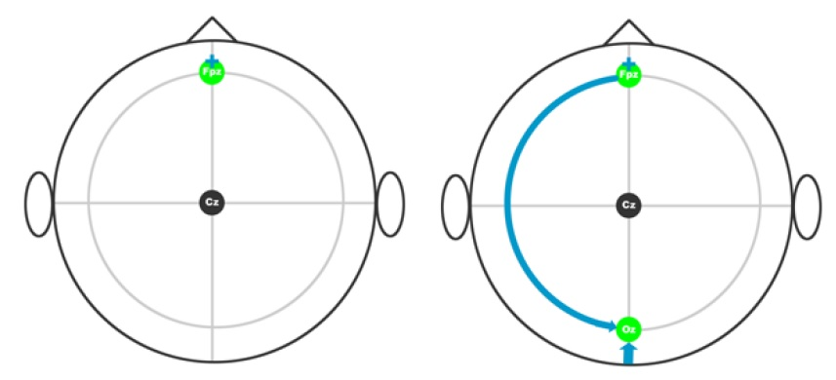
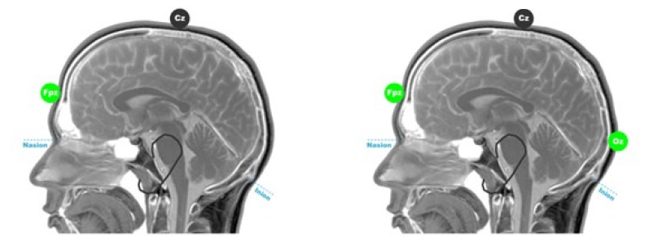
Electrode Placement Procedure:
Fig. 33, [7]

Slide 36
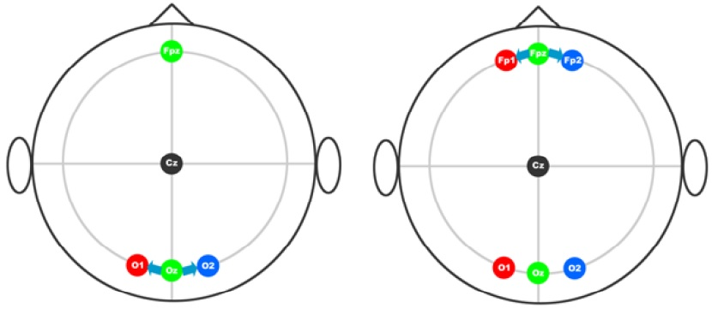
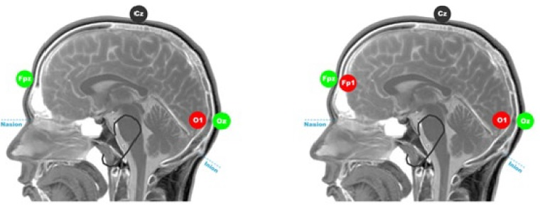
Electrode Placement Procedure:
Fig.34, [7]

Slide 37
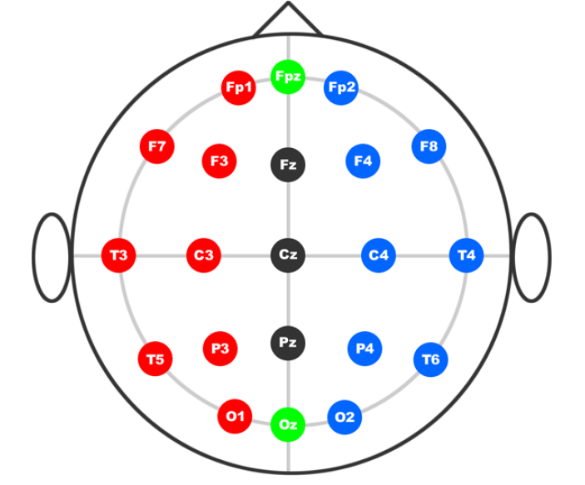
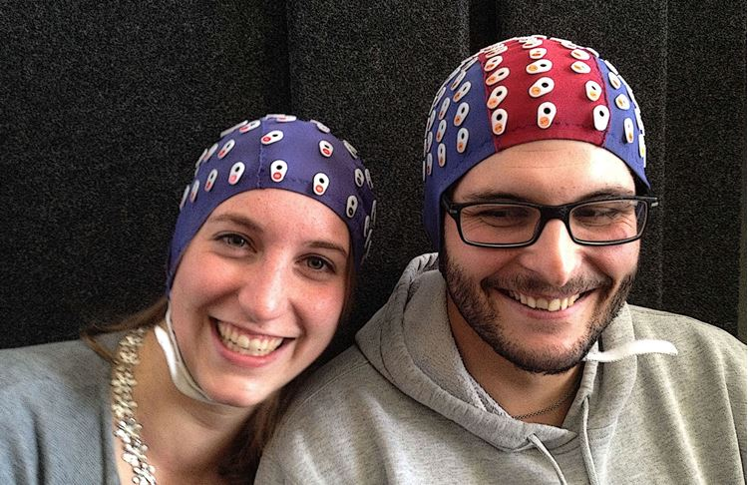
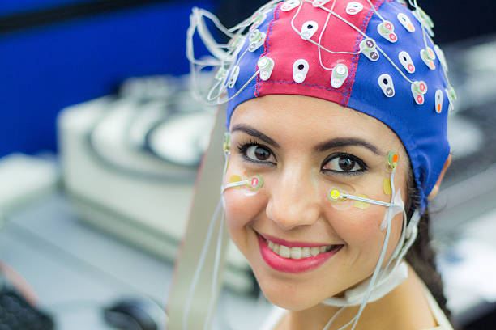
Electrode Placement Procedure:
Finally We get
Fig. 36, Source g.tec
Fig. 35, [7]

Slide 38
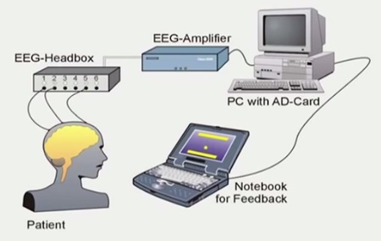
BCI
Brain Computer Interface
Traditional Definition: “The goal of BCI technology is to give severely paralyzed people another way to communicate, a way that does not depend on muscle control (Wadswort Center) [2,3]”
Traditional BCI System for Patient by Schmidt 2003
Fig. 37, [2]

Slide 39
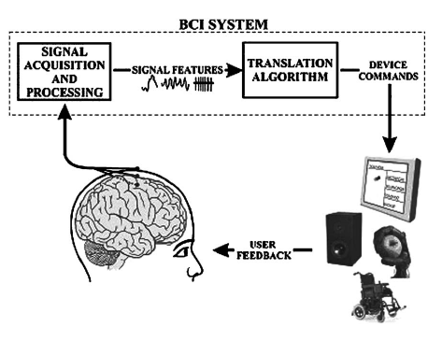
BCI
Brain Computer Interface
Other Definition of BCI:
Brain-computer interface(BCI) is a collaboration between a brain and device that enables signals from the brain to direct some external activity, such as control of a cursor and prosthetic limb.[2]
Brain-computer interface(BCI) system show great potential for effectively understanding human mental activities and intentions in their daily life.[2]
The Interface enables a direct communication pathway between the brain and the object to be controlled.[3]
BCI also called as MMI , DNI , and BMI
User
Fig. 38, [2]

Slide 40
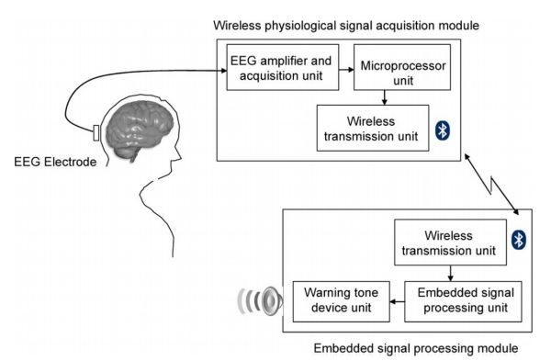
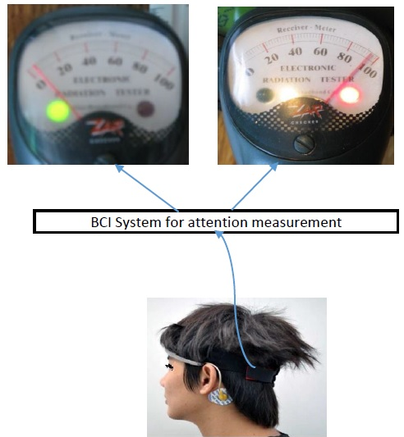
BCI
Technical Principles
BCI System fulfill these axioms[2]:
Input comes directly from the brain.
Signals are processed real time .
Commands that are executed must be completely intentional.
Fig.39, [10]
Fig. 40,

Slide 41
BCI
Technical Principles
Subtypes of BCI: BCI categorized by different aspect mentions in below.
Aspect of Signal Acquisition Environment
Invasive Environment
Non-invasive Environment
Aspect of working fundamental
Active BCI
Reactive BCI
Partially Invasive Environment
Passive BCI

Slide 42
Applications Area of BCI
Medical Applications of BCI [2,3]
2. Non-Medical Applications of BCI [2, 3]
Smart environment
Neuro-marketing and Media
Education and self-regulation
Games and entertainment
Security and authentication
Emotion Analysis
Area of Applications | Entity
Prevention | Smoking Alcoholism Motion sickness
Detection and Diagnosis | Tumors Brain disorder Sleep disorder
Rehabilitation and restoration | Brain stroke Disability Psychological disorders

Slide 43
Applications of BCI and ML

Slide 44
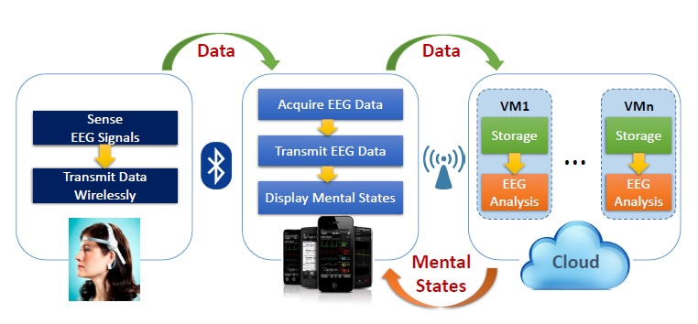
BCI Applications for mental state detection based on Mobile cloud Computing [9]
Fig41: System diagram of the proposed mobile-cloud-based BCI prototype, [9]

Slide 45
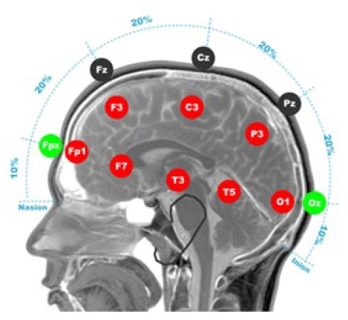
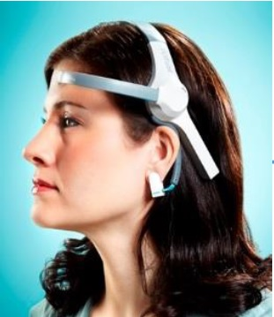
PROTOTYPE DEVELOPMENT[8]:
In this Model, author use commercially available, consumer-grade,wearable MindWave headset (NeuroSky, Inc., San Jose, CA).
The headset has one dry electrode to be placed on the forehead (known as FP1) and one ground electrode conveniently shaped as an earlobe clip.
Fig 42

Slide 46
PROTOTYPE DEVELOPMENT:
Data is sampled from the sensor at a rate of 128 Hz.
This device was chosen for two main reasons.
1. Firstly, the device is highly resistant to noise , as it has no moving cables, and the signals are immediately processed and digitized before being transmitted through Bluetooth.
2. The second reason is the connectivity.
In Mobile Cloud Computing Energy consumptions till now big challenges.
Bluetooth is becoming a standard low-energy wireless connection protocol
the MindWave headset offers unencrypted EEG signals and different libraries to work in different platforms, such as Android and iPhone.

Slide 47
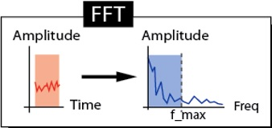
PROTOTYPE DEVELOPMENT
Fast Fourier Transform
1. The Fast Fourier Transform (FFT) is a mathematical process which is often used in EEG analysis to investigate the composition of an EEG signal [8] .
2. We can easily obtain the frequency distribution of EEG signals, since FFT transforms a signal from time domain into the frequency domain.
EEG frequency distribution is very sensitive to mental and emotional states as well as to the location of the electrode(s) [4].
Author use Go language [5] for its simplicity to implement concurrent programming, which allows the creation of many threads to take advantage of the multiple cores in the system.
Fig 43, [8]

Slide 48


PROTOTYPE DEVELOPMENT:
A proof-of-concept prototype of the proposed BCI framework has been developed based on a NeuroSky MindWave headset, a Google Galaxy Nexus smartphone with Android 4.2 OS, and a Linux server equipped with a quad-core Intel i7 microprocessor.
The headset connects to the smartphone through the Bluetooth 3.0 wireless protocol.
Communications between the smartphone and the cloud server is achieved through a dynamic URL on the the regular 802.11g Wi-Fi network

Slide 49
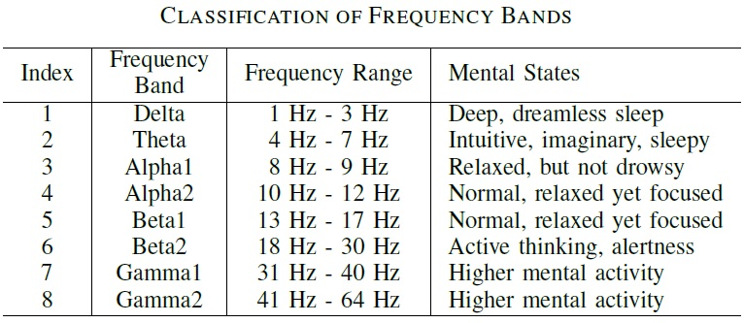
PROTOTYPE DEVELOPMENT
In Android development, Author chose the Eclipse IDE and used the ThinkGear.jar and aChartEngine.jar libraries provided by NeuroSky, which was particularly helpful to plot the real-time raw EEG signals on the smartphone.
An integrated software app was developed and deployed on the Android smartphone, including three built-in functional modules.
Table: 4, [9]

Slide 50
PROTOTYPE DEVELOPMENT:
Specifically, the first functional module is a graphical window capable of receiving and displaying continuous numerical EEG data acquired from the NuroSky headset
Fig44 : the sensor is not yet on place and thus the smartphone will display regular noise pattern at a frequency of 60 Hz [9].

Slide 51
PROTOTYPE DEVELOPMENT:
Fig45 : The sensor is now on place and the smartphone will display acquired EEG signals, which may be affected by external noise (1st peak) or eye movement (2nd peak) [9].

Slide 52
Result On Viewing Window:
Fig: 46, [9]
Fig 47, [9]
(a) Relaxed
(b) Active

Slide 53
On Viewing Window:
Fig 48, [9]
Fig 49, [9]
(c) Asleep
(d) Normal

Slide 54
Result On Viewing Window:
Fig 51, [9]
Fig : 50, [9]
(e) Sleepy
(f) Hyper active

Slide 55
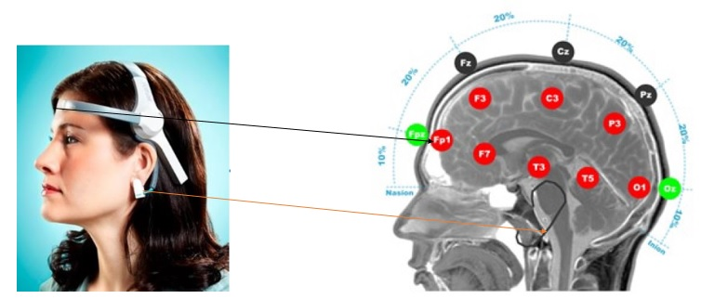
Drowsiness detection
In [5] author proposed a cloud based BCI system where signal processing phase happened in the cloud. User able to see only the raw signal time of signal recording and output on the his/her Mobile GUI.
Author used NeroSky Single electrode headset and developed a integrated android app.

Slide 56
Drowsiness detection
In [5], author objective is to proposed an automatic approach to detect the occurrence of driver drowsiness onset based on the Artificial Neuronal Network (ANN) and using only one EEG channel.
Author used only the EEG recorded from C3-O1 since in this work author only study the case where the characteristics are calculated from a single EEG channel.
Figure 52 (source): Electrode position in the International System 10-20[5,7]

Slide 57
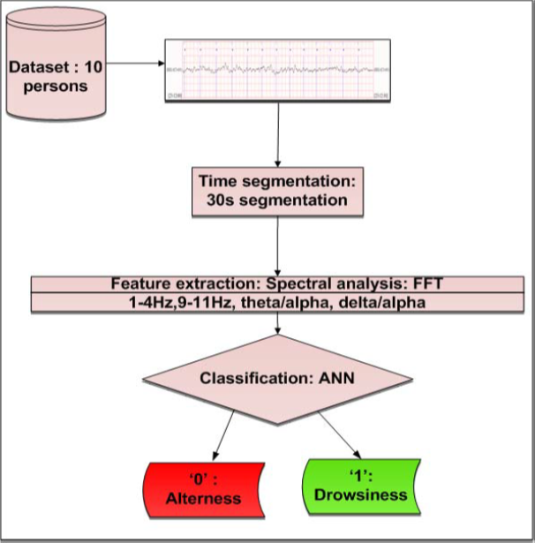
Drowsiness detection
Author used ANN for faster process because of parallel processing done in ANN
Author achieved 85.2% total accuracy for 35 hidden layer.
Fig-53, Author Proposed Model[4]

Slide 58
Channel selection and preprocessing
Sl. No. | Paper Details | Tools and Techniques Used
1 | Jianhua Yang, Harsimrat Singh, Evor L. Hines, Friederike Schlaghecken, Daciana D. Iliescu, Mark S. Leeson, Nigel G. Stocks, “Channel selection and classification of electroencephalogram signals: An artificial neural network and genetic algorithm-based approach”, Artificial Intelligence in Medicine, Volume 55, Issue 2, 2012, Pages 117-126. | ANN and genetic neural mathematic method (GNMM)
2 | Alireza Ghaemi, Esmat Rashedi, Ali Mohammad Pourrahimi, Mehdi Kamandar, Farhad Rahdari, “Automatic channel selection in EEG signals for classification of left or right hand movement in Brain Computer Interfaces using improved binary gravitation search algorithm”, Biomedical Signal Processing and Control, Volume 33, 2017, Pages 109-118. | Improved binary gravitation search algorithm
3 | Z. Wang, S. Hu and H. Song, "Channel Selection Method for EEG Emotion Recognition Using Normalized Mutual Information”, IEEE Access, vol. 7, pp. 143303-143311, 2019. | Normalized mutual information (NMI)
4 | S. Bavkar, B. Iyer and S. Deosarkar, "Rapid Screening of Alcoholism: An EEG Based Optimal Channel Selection Approach," IEEE Access, vol. 7, pp. 99670-99682, 2019. | Improved Binary Gravitational Search Algorithm (IBGSA)
5 | M. Arvaneh, C. Guan, K. K. Ang and C. Quek, "Optimizing the Channel Selection and Classification Accuracy in EEG-Based BCI," IEEE Transactions on Biomedical Engineering, vol. 58, no. 6, pp. 1865-1873, June 2011. | Sparse common spatial pattern (SCSP) algorithm

Slide 59
Channel selection approach proposed by S. Bavkar et al. 2019
S. Bavkar, B. Iyer and S. Deosarkar, "Rapid Screening of Alcoholism: An EEG Based Optimal Channel Selection Approach“, IEEE Access, vol. 7, pp. 99670-99682, 2019.

Slide 60
Channel selection approach proposed by S. Bavkar et al. 2019 [21]
Objective: The proposed method employs absolute gamma band power used as a feature and ensemble subspace K-NN used as a classifier to categorize alcoholics and normal subject. Furthermore, an Improved Binary Gravitational Search Algorithm (IBGSA) is reported as an optimization tool to select the optimum EEG channels for the rapid screening of alcoholism.
Dataset Used: The EEG database used for the present analysis is obtained from the University of California, Irvine Knowledge Discovery in Database (UCI KDD) Archive [19]. This database has 64 electrodes placed on the scalp of the human subjects. Each subject of 10 trials are used with one-second epoch.
Tools and Techniques Used:
Butterworth bandpass filter for of fourth order are used to separate EEG signals into delta, theta, Alpha, beta and gamma band as per their frequency range
For Channel selection, Genetic algorithm (GA), binary particle swarm optimization (BPSO), binary gravitational search algorithm (BGSA). And proposed Improved BGSA
Ensemble subspace K-NN used as a classifier to categorize alcoholics and normal subject.
Conclusion:
The proposed method provides the optimum channels which are necessary and sufficient to detect and predict the alcoholism. The IBGSA provided 92.50% detection accuracy with only 13 EEG channels: FP1, FPz, FP2, AF7, AF8, FC5, FC6, T7, TP7, TP8, Cz, PO8 and PO7.
Future Scope suggested:
In the future, the proposed work can be extended to improve the detection accuracy by using different combinations of optimization algorithms and deep learning techniques.
Further, the claims in this paper can be verified in real-time mode on the alcoholic subject.

Slide 61
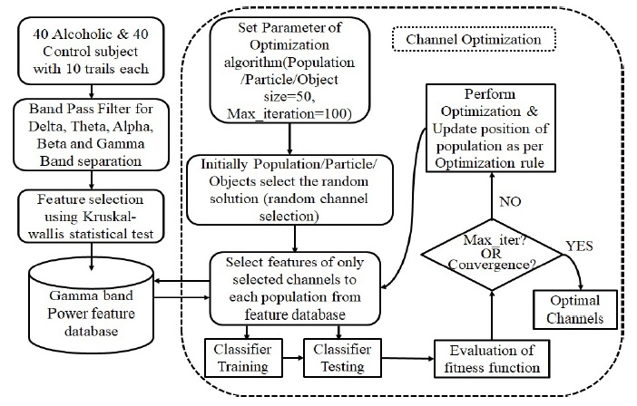
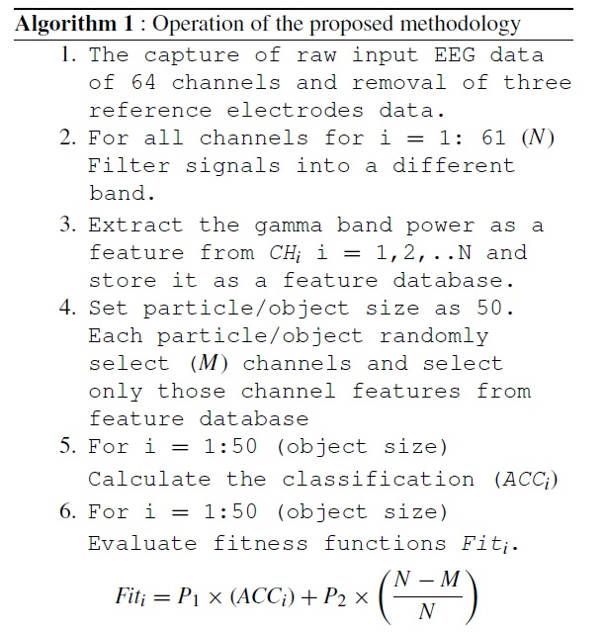

Techniques applied by S. Bavkar et al. 2019 [21] for Channel selection
Fig.12: Block diagram of the proposed methodology.

Slide 62


Results of proposed techniques estimated by S. Bavkar et al. 2019 [21]
Table5: Quantitative analysis of the proposed method: detection accuracy.
Discussion: However, author clearly mentioned in the paper that:
These methods are unattractive due to one or other reasons like complicated computational methodology or reduction in detection accuracy with a reduction in channels.
Table4: Comparative analysis of different classifiers using 10 fold cross validation.

Slide 63
Traditional Feature Extraction and Machine Learning approach for Epileptic Seizure Detection
Sl. No. | Paper Details | Tools and Techniques Used
1 | S. Khanmohammadi and C. Chou, "Adaptive Seizure Onset Detection Framework Using a Hybrid PCA–CSP Approach," in IEEE Journal of Biomedical and Health Informatics, vol. 22, no. 1, pp. 154-160, Jan. 2018. | Hybrid PCA–CSP Approach
2 | D. Wang et al., "Epileptic Seizure Detection in Long-Term EEG Recordings by Using Wavelet-Based Directed Transfer Function," in IEEE Transactions on Biomedical Engineering, vol. 65, no. 11, pp. 2591-2599, Nov. 2018. | Wavelet-Based Directed Transfer Function
3 | A. Gupta, P. Singh and M. Karlekar, "A Novel Signal Modeling Approach for Classification of Seizure and Seizure-Free EEG Signals," in IEEE Transactions on Neural Systems and Rehabilitation Engineering, vol. 26, no. 5, pp. 925-935, May 2018. | Filterbank and SVM
4 | S. N. Jothiraj, T. G. Selvaraj, B. Ramasamy, N. P. Deivendran and S. M.S.P, "Classification of EEG signals for detection of epileptic seizure activities based on feature extraction from brain maps using image processing algorithms," in IET Image Processing, vol. 12, no. 12, pp. 2153-2162, 12 2018. | ICA, CNGP, CTP and LSSVM
5 | L. S. Vidyaratne and K. M. Iftekharuddin, "Real-Time Epileptic Seizure Detection Using EEG," in IEEE Transactions on Neural Systems and Rehabilitation Engineering, vol. 25, no. 11, pp. 2146-2156, Nov. 2017. | HWPT, FD and RVM

Slide 64
Traditional Feature Extraction and ML approach by S. Khanmohammadi et al. 2018 for Epileptic Seizure Detection
S. Khanmohammadi and C. Chou, "Adaptive Seizure Onset Detection Framework Using a Hybrid PCA–CSP Approach“, in IEEE Journal of Biomedical and Health Informatics, vol. 22, no. 1, pp. 154-160, Jan. 2018.

Slide 65
Traditional Feature Extraction and ML approach by S. Khanmohammadi et al. 2018 [7] for Epileptic Seizure Detection
Objective: This paper presents a new adaptive patient-specific seizure onset detection framework that dynamically selects a feature from enhanced EEG signals to discriminate seizures from normal brain activity. The proposed framework employs principal component analysis and common spatial patterns to enhance the EEG signals and uses the extracted discriminative feature as an input for adaptive distance-based change point detector to identify the seizure onsets.
Dataset Used: Children’s Hospital Boston Massachusetts Institute of Technology (CHB-MIT) EEG dataset. The data consists of 916 hours of continuous scalp EEG recordings collected (at the Children’s Hospital in Boston) from 24 pediatric subjects (1.5-22 years old) suffering from intractable seizures.
Tools and Techniques Used:
In this study, author propose a hybrid approach that first reduces the dimensionality of the data using the PCA method and then improves the signal-to-noise ratio using the CSP approach.
Statistical and Morphological features extracted.
The final step of proposed framework consists of Adaptive Distance-based Change Point Detector (ADCD) to detect seizure onset in incoming signals.
Future Scope suggested:
A multiclass extension of this approach can be useful for detecting different stages of seizure cycle including preictal, interictal, and postictal. Automatic feature extraction methods based on deep learning can improve the performance of the proposed seizure onset detection framework.
Conclusion: Experimental results from the CHB-MIT EEG dataset show the computational efficiency of the proposed method (analyzing EEG signals in a time window of 3 s within 0.1 s) while providing comparable results to the existing methods in terms of average sensitivity, latency, and false detection rate. The proposed method is advantageous for real-time monitoring of epileptic patients and could be used to improve early diagnosis and treatment of patients suffering from recurrent seizures.

Slide 66

Techniques applied by S. Khanmohammadi et al. 2018 [7] for Seizure Detection
Proposed Model:
Extracted Features:
Fig. 13: Overview of proposed seizure onset detection framework, Source: S. Khanmohammadi et al. 2018.
Feature Type | Statistical | Morphological
Feature Name | 1) Minimum, 2) Maximum, 3) Mean, 4) Variance, 5) Standard Deviation, 6) Range, 7) Kurtosis, 8) Skewness and 9) Root Mean Square | 1) Curve Length, 2) Zero Cross, 3) Number of Peaks, 4) Average Non-Linear Energy and 5) Band Power

Slide 67




Results of proposed techniques mentioned by S. Khanmohammadi et al. 2018 [7]
Result Estimated by the Authors:
Fig.15
Fig.14
Fig.17
Fig.16

Slide 68
Deep Learning based approaches for Epileptic Seizure Detection
Sl. No. | Paper Details | Tools and Techniques Used
1 | U. Rajendra Acharya, Shu Lih Oh, Yuki Hagiwara, Jen Hong Tan, Hojjat Adeli, “Deep convolutional neural network for the automated detection and diagnosis of seizure using EEG signals”, Computers in Biology and Medicine, Volume 100, 2018, Pages 270-278. | 13-layer deep convolutional neural network (CNN) algorithm
2 | Y. Yuan, G. Xun, K. Jia and A. Zhang, “A Multi-View Deep Learning Framework for EEG Seizure Detection”, IEEE Journal of Biomedical and Health Informatics, vol. 23, no. 1, pp. 83-94, Jan. 2019. | Multi-View Deep Learning
3 | Ali Emami, Naoto Kunii, Takeshi Matsuo, Takashi Shinozaki, Kensuke Kawai, Hirokazu Takahashi, “Seizure detection by convolutional neural network-based analysis of scalp electroencephalography plot images”, NeuroImage: Clinical, Volume 22, 2019, 101684, | convolutional neural networks
4 | Zuochen Wei, Junzhong Zou, Jian Zhang, Jianqiang Xu, “Automatic epileptic EEG detection using convolutional neural network with improvements in time-domain”, Biomedical Signal Processing and Control, Volume 53, 2019, 101551 | 12-layers CNN, GAN, Wasserstein Generative Adversarial Nets (WGANs),
5 | Weixia Liang, Haijun Pei, Qingling Cai, Yonghua Wang, “Scalp EEG epileptogenic zone recognition and localization based on long-term recurrent convolutional network, Neurocomputing, 2019, In press. | Long-term recurrent convolutional network

Slide 69
Deep Learning based approaches for Epileptic Seizure Detection
U. Rajendra Acharya, Shu Lih Oh, Yuki Hagiwara, Jen Hong Tan, Hojjat Adeli, “Deep convolutional neural network for the automated detection and diagnosis of seizure using EEG signals”, Computers in Biology and Medicine, Volume 100, 2018, Pages 270-278.

Slide 70
Deep Learning based approach by U. Rajendra Acharya et al. 2018 [22]
Objective:
This is the first study to employ the convolutional neural network (CNN) for analysis of EEG signals. In this work, a 13 layer deep convolutional neural network (CNN) algorithm is implemented to detect normal, preictal, and seizure classes.
Dataset Used: The University of Bonn, Germany EEG database have been used in this experiment.
Future Scope suggested:
The main drawback of this work is the lack of huge EEG database. Proposed algorithm requires a diversity of data to obtain an optimum performance.
The performance of this technique can be improved by applying a bagging algorithm and increasing the number of samples.
Need to consider spatial and temporal domain features
Tools and Techniques Used:
Ten-fold cross validation strategy.
13-layer deep CNN structure.
Conclusion: A novelty of this proposed model is being the first application of deep neural network for EEG-based seizure detection. A 13-layer deep learning CNN algorithm is implemented for the automated EEG analysis. An average accuracy of 88.7% is obtained with a specificity of 90% and a sensitivity of 95%. The advantage of the model presented in this paper, however, is separate steps of feature extraction and feature selection are not required in this work.

Slide 71


Techniques applied by U. Rajendra Acharya et al. 2018 [22] for Seizure Detection
Fig.18: The allocation of EEG data used for training and testing the proposed algorithm.
Table6: The details of CNN structure used in this research.

Slide 72


Results of proposed techniques estimated by U. Rajendra Acharya et al. 2018 [22]
Table7: The confusion matrix across all ten-folds.
Discussion:
Even though this proposed model could not yield the best classification performance as compared to the published works mentioned in the paper. the proposed CNN model still managed to obtain 88.67% accuracy, 95.00% sensitivity, and 90.00% specificity. This shows that given more EEG data, the proposed model can achieve better results with minimum pre-processing of the EEG data.
Table8: The overall classification result across all ten-folds.

Slide 73
Summary of Work Done

Slide 74

Summary of Work Done
Related to Objective-1: “Performance analysis of different existing classifiers over EEG seizure data and comparative Study” [2] (6th UPCON 2019, IEEE)
This work compares the performance of
classifiers Neural Networks, Support Vector Machines, Linear Discriminant Analysis and Extreme Learning Machines
Two different datasets used for the experiments are (a) EEG database by University of Bonn [11], Germany for single channel recordings, (b) CHB-MIT[10] dataset for multi-channel recordings.
In all these experiments, we assume that the recordings, after preprocessing, are all free from such defects which could affect the performance of different classifiers differently.
For preprocessing, filtered recordings are segmented and DWT is applied on them to use the transform coefficients for feature extraction.
These extracted features were then fed into various classifiers. It was observed that ELM classifiers could perform at par or better than the conventional classification methods.
Figure 1: Illustration of the Procedural Flow [2]
Refe. [2]

Slide 75
Summary of Work Done
Related to Objective-1: “Performance analysis of different existing classifiers over EEG seizure data and comparative Study”[2] (6th UPCON 2019, IEEE)
University of Bonn Dataset[11]:
Accuracy: ELM model yielded an accuracy of 99.6875%, outperforming SVM, LDA and ANN at 59.38%, 90% and 97.1875% respectively.
Precision: all the classifiers achieve a perfect precision score of 100%.
Recall: ELM has obtained highest recall score of 99.39, outperforming ANN, SVM and LDA at 94.49%, 80.37% and 80.37% respectively.
F1-score: ELM has a F1-score of 99.69%, while ANN has 97.16%, SVM has 89.12%, and LDA also has 89.12%.
CHB-MIT dataset[10]:
Accuracy: ANN, ELM, LDA, and SVM each have performed with an average accuracy score of 98.43% , 98.27%, 99.14%, and 98.00%, respectively.
Average Precision Scores on CHB-MIT:
Class | ANN | ELM | LDA | SVM
Seizure Class | 0.470988 | 0.34592 | 0.738895 | 0.041667
Non-Seizure Class | 0.994202 | 0.986654 | 0.996428 | 0.986654
AVERAGE RECALL SCORES ON CHB-MIT:
Class | ANN | ELM | LDA | SVM
Seizure Class | 0.202349 | 0.058648 | 0.714246 | 0.000271
Non-Seizure Class | 0.999749 | 0.999568 | 0.996196 | 1
AVERAGE F1-SCORES ON CHB-MIT:
Class | ANN | ELM | LDA | SVM
Seizure Class | 0.269075 | 0.084818 | 0.715283 | 0.000538
Non-Seizure Class | 0.992009 | 0.991181 | 0.99558 | 0.989839
Refe. [2]

Slide 76

Summary of Work Done
Related to Objective-2: “EEG channel selection scheme implementation and testing over the seizure data” [5] 7th SPIN 2020, IEEE
The proposed methodology consists of a channel selection technique which integrates Binary Particle Swarm Optimization (BPSO) with Extreme Learning Machine (ELM) to give the optimized set of channels.
The proposed methodology achieved a maximum detection accuracy of 93.21% with only 6/23 channels, whereas ELM achieved a maximum detection accuracy of 90.27% without channel Selection.
Refe. [5]
Figure 2: Block diagram for the proposed channel selection methodology

Slide 77



Summary of Work Done
Related to Objective-2: “EEG channel selection scheme implementation and testing over the seizure data”[5] 7th SPIN 2020, IEEE
Figure 3: Shows Estimated Classification Accuracy over the selected channels.
Figure 4: Shows Number of channels selected with respect to Fitness
functions and Subject
Here, N1 represents total channels (23 in our case), N2 is the number of channels selected. P1 is the weightage given to detection Accuracy, P2 is the weightage given to reduction in number of channels, such that P1+P2=1, Accuracy represents achieved detection accuracy of ELM.

Slide 78


Summary of Work Done
Related to Objective-2: “EEG channel selection scheme implementation and testing over the seizure data”
This work has been extended with Jaya algorithm and Genetic Algorithm to address that the search heuristic bio-inspired optimization algorithm could be use full for the EEG channel selection for seizure detection.
Figure 5: Shows Number of channels selected using each method
Figure 6: Shows Estimated Detection Accuracy using each method

Slide 79

Summary of Published Work
Related to Objective-3: “Normal, pre-ictal, ictal, interictal EEG data analysis to propose a scheme for seizure detection”
Paper Title: “A Multi-View SVM Approach for Seizure Detection from Single Channel EEG signals”[6], IETE Journal of Research
Figure 7. Illustration of the proposed approach

Slide 80

Summary of Published Work
Related to Objective-3: “Normal, pre-ictal, ictal, interictal EEG data analysis to propose a scheme for seizure detection”
Paper Title: “A Multi-View SVM Approach for Seizure Detection from Single Channel EEG signals”[6], IETE Journal of Research
SVM-2K:
J. D. R. Farquhar, H. Meng, S. Szedmak, D. R. Hardoon, and J. Shawe-taylor, “Two view learning: Svm-2k, theory and practice”. In NIPS. MIT Press, 2006.
Refe. [6]

Slide 81
Summary of Published Work
Related to Objective-3: “Normal, pre-ictal, ictal, interictal EEG data analysis to propose a scheme for seizure detection”
Table 1. Estimated results (detection accuracy) based on different views of SVM
Table 2. Results obtained by proposed multi view SVM
Cases | Single view SVM | Single view SVM | SVM | Multi-View SVM
 | Features by ICA | PSD Features | Concatenation of ICA and PSD features | ICA and PSD features
A vs E | 94.06% | 96.88% | 95.51% | 99.54%
B vs E | 90.43% | 95.57% | 94.41% | 99.43%
C vs E | 92.40% | 95.07% | 94.27% | 98.16%
D vs E | 90.80% | 92.10% | 91.45% | 96.17%
AB vs E | 94.34% | 97.77% | 96.81% | 99.45%
CD vs E | 93.09% | 95.44% | 93.57% | 97.05%
ABCD vs E | 95.56% | 96.43% | 96.02% | 97.63%
Cases | Accuracy (%) | Sensitivity (%) | Specificity (%) | f1 score (<=1) | AUC (<=1)
A vs E | 99.54 | 99.53 | 99.55 | 0.99 | 0.9990
B vs E | 99.43 | 99.45 | 99.42 | 0.99 | 0.9994
C vs E | 98.16 | 97.53 | 98.81 | 0.98 | 0.9974
D vs E | 96.17 | 96.32 | 96.04 | 0.96 | 0.9874
AB vs E | 99.45 | 99.63 | 99.09 | 0.99 | 0.9989
CD vs E | 97.05 | 97.90 | 95.38 | 0.96 | 0.9792
ABCD vs E | 97.63 | 98.38 | 94.67 | 0.95 | 0.9764
Refe. [6]

Slide 82

Summary of Published Work
Related to Objective-3: “Normal, pre-ictal, ictal, interictal EEG data analysis to propose a scheme for seizure detection”
Paper Title: “DWT-EMD Feature level Fusion based Approach over Multi and Single Channel EEG Signals for Seizure Detection ”[Communicated, Revision submitted] [8]
This work proposes DWT-EMD Feature level Fusion based Seizure Detection approach over Multi and Single Channel EEG Signals and studied the usability of discrete wavelet transform (DWT) and empirical mode decomposition (EMD) features fusion with respect to individual DWT and EMD features over the classifiers SVM, SVM with RBF kernel, Decision Tree and Bagging Classifier for Seizure detection.
All classifiers achieved an improved performance over DWT-EMD feature level fusion for two benchmark seizure detection EEG datasets (CHB-MIT [10] and University of Bonn [11]).
Figure 8. Illustrative diagram of the proposed approach.

Slide 83
Summary of Published Work
Related to Objective-3: “Normal, pre-ictal, ictal, interictal EEG data analysis to propose a scheme for seizure detection”
Paper Title: “DWT-EMD Feature level Fusion based Approach over Multi and Single Channel EEG Signals for Seizure Detection ”[Communicated, Revision submitted]
Performance of the proposed approach:
For the Dataset-1 (Multi-Channel)[10]:
SVM achieved 91.42% accuracy, 91.42% F-1 Score, 83.00% MCC,
SVM-RBF achieved 91.42% accuracy, 90.32% F-1 Score, 82.78% MCC,
Decision Tree achieved 91.42% accuracy, 92.30% F-1 Score, 84.01% MCC, and
Bagging Classifier achieved 94.28% accuracy, 94.73% F-1 Score, 89.11% MCC
For Dataset-2 (Single-Channel)[11]:
SVM achieved 99.37% accuracy, 99.38% F-1 Score, 98.75% MCC,
SVM-RBF achieved 100% accuracy, 100% F-1 Score, 100% MCC,
Decision Tree achieved 99.58% accuracy, 99.56% F-1 Score, 99.16% MCC, and
Bagging Classifier achieved 100% accuracy, 100% F-1 Score, 100% MCC.

Slide 84

Summary of Published Work
Related to Objective-4: “Advance Machine Learning approach for Seizure Detection”
Paper Title: “A 1D-CNN-Spectrogram Based Approach for Seizure Detection from EEG Signal” [3] 2nd ICCIDS 2019, Elsevier
Main objective in this work is to represent a methodology with the combination of two methods namely Spectrogram and 1D CNN which can be one possible approach for seizure detection.
Data used from CHB-MIT scalp EEG dataset [10]
An average accuracy of the proposed Spectrogram-CNN based scheme has been estimated up to 77.57%.
In [Ɨ],pyramidal one-dimensional CNN has been used for epilepsy detection and the author clearly mentioned: “1D-CNN involves 61% fewer parameters compared to standard CNN models”.
Figure 9: Proposed Seizure detection model based on Spectrogram and 1D-CNN
[Ɨ] Ihsan Ullah, Muhammad Hussain, Emad-ul-Haq Qazi and Hatim Aboalsamh. (2018) "An automated system for epilepsy detection using EEGbrain signals based on deep learning approach.", Expert Systems with Applications 107(1): 61-71
Refe. [3]

Slide 85


Summary of Published Work
Related to Objective-4: “Advance Machine Learning approach for Seizure Detection”
Paper Title: “A Deep Transfer Learning Approach for Seizure detection using RGB features of Epileptic Electroencephalogram Signals” [4] 11th CloudCom 2019, IEEE (Tier-II)
This paper demonstrates an approach based on Deep Transfer Learning for the classification for Seizure and Non-seizure Electroencephalogram (EEG) signals.
It has been found in literature and our previous, Seizure detection performance is not satisfactory over small EEG dataset using traditional approaches.
The Transfer learning approach overcomes this by reusing the pre-trained networks such as googlenet, resnet101 and vgg19.
Out of these three pre-trained network googlenet achieved 99% accuracy with less no of epoch than other takes. On the other hand googlenet takes lees CPU time than other two models.
Figure 11: Approach applied in reusing the pre-trained network
Figure 10: Transfer learning architecture

Slide 86

Summary of Published Work
Related to Objective-4: “Advance Machine Learning approach for Seizure Detection”
Paper Title: “Capsule Neural Network based approach for subject specific and cross-subjects seizure detection from EEG signals”[Communicated, Under Review] [9]
This work proposes a fine-tuned Capsule Neural Network (CapsNet) based approach to discriminate seizure and non-seizure EEG signals through subject specific and cross subject training and testing.
In this experiment,
First we have normalized the input data using L2 normalization technique.
In the second step, the normalized data have been given to the CapsNet and model level fine-tuning has been done.
Finally, for comparison purposes we have performed three more classification techniques such as Decision Tree, Logistic Regression, Convolutional Neural Network to compare with proposed approach.
To estimate the effectiveness of the proposed approach we performed subject specific and cross subject training and testing experiment.
In this study, we have used Multi-channel (CHB-MIT [10]) and Single channel (University of Bonn [11]) benchmark EEG datasets to test the proposed approach.
Figure 12: Flowchart of the proposed approach

Slide 87
Summary of Published Work
Table 3: Subject Specific Estimated performance for five subjects of Dataset-1
Approaches | Performance Evaluation Parameter | Subject1 | Subject2 | Subject1 | Subject4 | Subject5 | Mean Performance
Logistic Regression | Accuracy | 75.49% | 52.80% | 60.0% | 79.29% | 53.88% | 64.292%
 | sensitivity | 72.22% | 52.69% | 59.81% | 75.50% | 54.21% | 63.886%
 | specificity | 79.80% | 52.91% | 60.28% | 85.59% | 53.56% | 66.428%
 | FPR | 0.2019 | 0.4708 | 0.3971 | 0.1540 | 0.4643 | 0.33762
 | AUC score | 0.7601 | 0.5280 | 0.6005 | 0.8005 | 0.5388 | 0.64558
 | F1 score | 0.7700 | 0.5294 | 0.6458 | 0.8097 | 0.5364 | 0.65826
Decision tree | Accuracy | 81.48% | 80.44% | 84.62% | 78.04% | 83.68% | 81.652%
 | Sensitivity | 82.95% | 80.38% | 85.71% | 78.55% | 82.19% | 81.956%
 | Specificity | 80.02% | 80.50% | 83.45% | 78.04% | 85.18% | 81.438%
 | FPR | 0.1997 | 0.1949 | 0.1654 | 0.2246 | 0.1481 | 0.18654
 | AUC score | 0.8149 | 0.8044 | 0.8458 | 0.7804 | 0.8369 | 0.81648
 | F1 score | 0.8167 | 0.8040 | 0.8528 | 0.7832 | 0.8351 | 0.81836
CNN | Accuracy | 89.44% | 85.91% | 92.61% | 89.56% | 90.50% | 89.604%
 | Sensitivity | 92.58% | 82.84% | 92.29% | 88.58% | 88.69% | 88.996%
 | Specificity | 86.33% | 88.90% | 92.96% | 90.55% | 92.02% | 90.152%
 | FPR | 0.1336 | 0.1102 | 0.0703 | 0.0944 | 0.0797 | 0.09818
 | AUC score | 0.8946 | 0.8590 | 0.9263 | 0.8957 | 0.9035 | 0.89582
 | F1 score | 0.8972 | 0.8544 | 0.9285 | 0.8955 | 0.9023 | 0.89558
CapsNet | Accuracy | 98.17% | 96.13% | 93.47% | 88.75% | 91.00% | 93.50%
 | sensitivity | 98.36% | 95.78% | 95.26% | 86.24% | 90.35% | 93.19%
 | specificity | 97.98% | 96.49% | 91.66% | 91.72% | 91.67% | 93.90%
 | FPR | 0.0201 | 0.0350 | 0.0833 | 0.0827 | 0.0832 | 0.05186
 | AUC score | 0.9817 | 0.9613 | 0.9353 | 0.8872 | 0.9099 | 0.93508
 | F1 score | 0.9818 | 0.9614 | 0.9361 | 0.8925 | 0.9112 | 0.9366

Slide 88
Summary of Published Work
Table 4: Estimated Performance of proposed approach in Cross subject experiment over the Dataset-1
Cases | Training Vs. Testing |  | Performance of proposed approach
 | Training Subject | Testing Subject | Accuracy | sensitivity | specificity | FPR | AUC score | F1 score
Case-1 | Subject1 | Subject2 | 87.08% | 81.79% | 94.44% | 0.0555 | 0.8712 | 0.8804
 |  | Subject3 | 91.21% | 98.60% | 85.20% | 0.1479 | 0.9153 | 0.9092
 |  | Subject4 | 95.38% | 97.71% | 93.66% | 0.0633 | 0.9540 | 0.9536
 |  | Subject5 | 67.17% | 60.55% | 99.29% | 0.0070 | 0.6695 | 0.7536
Mean Performance |  |  | 85.21% | 84.66% | 93.14% | 0.0684 | 0.8525 | 0.8742
Case-2 | Subject2 | Subject1 | 95.58% | 98.31% | 93.60% | 0.0639 | 0.9581 | 0.9569
 |  | Subject3 | 88.23% | 98.85% | 80.70% | 0.1925 | 0.8868 | 0.8742
 |  | Subject4 | 95.24% | 98.10% | 92.63% | 0.0736 | 0.9528 | 0.9517
 |  | Subject5 | 66.60% | 60.16% | 98.68% | 0.0131 | 0.6638 | 0.7500
Mean Performance |  |  | 86.41% | 88.85% | 91.40% | 0.0857 | 0.8653 | 0.8832
Case-3 | Subject3 | Subject1 | 79.39% | 70.87% | 99.13% | 0.0086 | 0.7949 | 0.8277
 |  | Subject2 | 64.44% | 58.45% | 98.31% | 0.0168 | 0.6454 | 0.7364
 |  | Subject4 | 94.08% | 90.07% | 99.15% | 0.0084 | 0.9400 | 0.9444
 |  | Subject5 | 51.60% | 50.97% | 99.22% | 0.0077 | 0.5127 | 0.6752
Mean Performance |  |  | 72.37% | 67.59% | 98.95% | 0.0103 | 0.7232 | 0.7959
Case-4 | Subject4 | Subject1 | 80.94% | 84.04% | 98.20% | 0.0179 | 0.8998 | 0.9069
 |  | Subject2 | 75.37% | 67.43% | 96.24% | 0.0375 | 0.7542 | 0.7987
 |  | Subject3 | 93.80% | 96.69% | 90.99% | 0.0900 | 0.9392 | 0.9389
 |  | Subject5 | 56.90% | 53.87% | 98.52% | 0.0147 | 0.5661 | 0.6997
Mean Performance |  |  | 76.52% | 75.50% | 95.98% | 0.0400 | 0.7898 | 0.8360
Case-5 | Subject5 | Subject1 | 55.15% | 53.65% | 58.25% | 0.4174 | 0.5524 | 0.6169
 |  | Subject2 | 54.81% | 53.78% | 56.49% | 0.4350 | 0.5483 | 0.5966
 |  | Subject3 | 59.10% | 59.99% | 57.98% | 0.4201 | 0.5882 | 0.6245
 |  | Subject4 | 55.22% | 55.13% | 55.22% | 0.4465 | 0.5511 | 0.5874
Mean Performance |  |  | 56.07% | 55.63% | 56.98% | 0.4297 | 0.5600 | 0.6063

Slide 89
Performance Estimation and Analysis over the Supervised Learning Approaches for Motor Imagery EEG Signals Classification
Return

Slide 90
Introduction and Goal Statement
Problem Definition: Comparative Analysis of different machine learning algorithms over the classification of different motor imagery actions (Right Hand and Foot Here).
Motor Imagery actions encompasses the imagination of different motor actions e.g, movement of left hand or movement of right hand, but without muscle movement.
Machine Learning is now becoming state of art technology into this.
Imagination of actions (motor)
Performance of motor actions by subjects.
Data Collection
Data in form of signals are collected from subject
Brain Computer Interface Techniques applicable
ML Algorithms based Classification
Different Machine Learning algorithms are trained on signal data
Feature extraction, followed by classification brings out some results.
Produces activity in the specific regions of brain.
Return

Slide 91
Experimental Methodology
Following flowchart is the depiction of experimental procedure:
Provided with the Motor Imagery dataset containing the EEG signals for the different motor imagery tasks in our case it its right hand (R) and Right Foot (F), it will be followed by different steps before being passed to classifiers.
Segment Extraction: Input Raw EEG signals data are provided by the BCI Competition III-Dataset-IVa.
Feature Extraction: In this phase, transformed EEG values from segmented signal is taken as representative for that original signals these extraction strategies model the relevant data for the classification strategies in order to pass into the classifiers, furthermore producing results. In this phase FFT (Fast Fourier Transform has been applied to convert time domain signals to frequency domain signals).
Raw EEG signals
Segment Detection
Feature Extraction
Classification Tasks using ML algorithms
Output/ Prediction on Test Data
Return

Slide 92
Dataset Description
We have considered the EEG motor imagery classification problem by BCI competition III. The dataset used is Dataset IVa.
5 subjects are considered for this datset: (aa,al,av,aw,ay)
An EEG cap of 128 Ag/AgCl electrodes is used, out of which 118 were considered for data acquisition purposes.
They recorded their EEG signals for 3.5 seconds with 100 Hz sampling rate for each trial. For each subject they conducted 280(hand 140/ foot 140) trials.
Return

Slide 93
Dataset Split Description
For the experimental procedure of this paper, we have made the dataset of a single subject into 70-30 ratio (by percentage). The overall data provided to us was partitioned into two section namely training set that comprises of 70% of original dataset, while other part being 30% of the original dataset.
For the purpose of this experiment we have considered the samples from the dataset where the labels were provided so that accuracy can be measured for the “goodness” of the model.
Following table provides the subject wise training and testing data split:
Subject Name | Training Dataset | Testing Dataset
“aa” | 118 | 50
“al” | 125 | 53
“av” | 55 | 23
“aw” | 39 | 17
“ay” | 15 | 22
Return

Slide 94
Classification Models
For this experiment following seven models are considered:
Deep Neural Networks
Support Vector Machines (SVMs with kernels RBF & Sigmoid)
K-Nearest Neighbors (KNN)
Naïve Bayes’ (NB)
Decision Trees (DT)
Random Forests (RB)
Deep Neural Network: DNN configured with 4 layers has been used for this paper. These 4 layers are input layer, hidden layer-1, hidden layer-2 and output layer. Binary cross entropy loss function and sigmoid activation function is used for all layers in DNN model. 118 frequency domain features are fed to the input layer.
Support Vector Machine: One of the most simple and efficient models provided with the functionality of Kernel functions is considered. For the implementation of this paper, two kernels have been considered:
RBF Kernel(Radial Basis Function)
Sigmoid Kernel
Return

Slide 95
Classification Models (contd.)
Naïve Bayes’ Classifier: Naïve Bayes’ classifier depend upon the probabilistic analysis for classification. These classifiers are based on Bayes theorem. It is not a single algorithm but a family of algorithms where all of them share a common principle, i.e. every pair of features being classified is independent of each other.
K-Nearest Neighbor(KNN): KNN is a simple, supervised machine learning algorithm that can be used to solve both classification and regression problems. KNN algorithms use data and classify new data points based on similarity measures (e.g. distance function). In the implementation of this paper KNN with 3 nearest neighbor has been taken in order to classify the test data correctly.
Random Forest: This algorithm works by preparing multiple decision trees at the time of their training. The final output is determined by either mode or mean of different decision trees taken. It is a type of ensemble learning.
Decision Trees: These classifiers have capability of representing the information in terms of trees. The same input data has been provided to this classifier which is provided to other classifiers. The maximum depth of decisions trees for this experiment has been considered as 3.
Return

Slide 96
Prediction Results & Accuracy
The subject wise accuracy of different models is depicted in the table below:
Model | Subject aa | Subject al | Subject av | Subject aw | Subject ay
DNN | 63.99% | 67.30% | 63.77% | 80.39% | 76.19%
SVM (RBF Kernel) | 54.00% | 45.28% | 47.82% | 35.29% | 57.14%
SVM (Sigmoid Kernel) | 54.00% | 45.28% | 43.47% | 35.29% | 57.14%
Naïve Bayes | 48.00% | 39.62% | 52.17% | 35.29% | 42.85%
KNN | 42% | 47.16% | 52.17% | 64.70% | 57.14%
Random Forest | 50% | 24.52% | 56.52% | 23.52% | 57.14%
Decision Tree | 44.0% | 11.32% | 69.56% | 11.76% | 71.42%
Return

Slide 97
Result Discussion on SVM-RBF Model
The RBF kernel based SVM model performed quite good for some subjects only after the output and accuracy measure analysis in the previous section it can be seen that the SVM reached the maximum accuracy of 57.14% for subject ay. Following table if depiction of the SVM analysis:
Subject | Accuracy
“aa” | 54.00%
“al” | 45.28%
“av” | 47.82%
“aw” | 35.29%
“ay” | 57.14%
Return

Slide 98

Result Discussion on SVM-Sigmoid Model
The SVM Sigmoid model is based on Sigmoid Kernel function has performed comparable to the SVM RBF model. The Sigmoid model also didn’t show any improvement in accuracy of the SVM model. The highest accuracy achieved was with the subject ay as with the SVM RBF kernel.
The following table is the depiction of the same:
Subject | Accuracy
“aa” | 54.00%
“al” | 45.28%
“av” | 43.47%
“aw” | 35.29%
“ay” | 57.14%
Return

Slide 99

Result Discussion on Naïve Bayes’ Model
The Naïve Bayes’ model uses the probabilistic analysis for the estimation of the likelihood of the data point for the classification. The classification accuracy with the given dataset was found to be not very satisfactory in the case of any of the subjects, the highest accuracy achieved was 52.17% with the subject av.
The following table is the depiction of same:
Subject | Accuracy
“aa” | 48.00%
“al” | 39.62%
“av” | 52.17%
“aw” | 35.29%
“ay” | 42.85%
Return

Slide 100

Result Discussion on KNN model
K-Nearest Neighbor model is based on calculating the likelihood of the data point from each other using the different distance metrics, the KNN model performed relatively well and provided the highest accuracy of 64.70% over subject aw.
The following table is depiction of same:
Subject | Accuracy
“aa” | 42.00%
“al” | 47.16%
“av” | 52.17%
“aw” | 64.70%
“ay” | 57.14%
Return

Slide 101

Result Discussion on Random Forest model
The Random Forest method employs Ensemble Learning algorithm in ML for the estimation of class, the model in our experiment attained the maximum accuracy of 57.14% while the model performance was also not good with the other subjects as compared to other model’s performance.
The following table is the depiction of same:
Subject | Accuracy
“aa” | 50.00%
“al” | 24.52%
“av” | 56.52%
“aw” | 23.52%
“ay” | 57.14%
Return

Slide 102

Result Discussion on Decision Tree model
The decision tree model which represent the model classification rules in the form of tree, the model in our case not performed satisfactory as compared to other models, the maximum accuracy achieved in our experimental procedure was found to be 71.42% while on the other hand the minimum accuracy achieved was 11.32% with the subject al.
The following table is depiction of same:
Subject | Accuracy
“aa” | 44.0%
“al” | 11.32%
“av” | 69.56%
“aw” | 11.76%
“ay” | 71.42%
Return

Slide 103

Result Discussion on DNN model
The DNN model with the number of epochs and layered structure have provided the best accuracy for our experimental results, the overall accuracy per subject and the maximum accuracy of 80.39% was observed with aw subject. We found that the DNN model would be the best suited model for the experiment modeled with this type of data.
The following table is depiction of same:
Subject | Accuracy
“aa” | 63.99%
“al” | 67.30%
“av” | 63.77%
“aw” | 80.39%
“ay” | 76.19%
Return

Slide 104

Training procedure of DNN model
The training graph of loss function with the epochs and laccuracy is depicted for the reference , for the subject aa is depicted in the following figure:
The accuracy has been stabilizing over the number of epochs which is evident from the graphs:
Return

Slide 105

Training procedure of DNN model
The loss function vs the epoch graph depicts the variation into the training procedure of the loss function being used. The depiction of the graph for the subject aa has been shown here for reference:
Return

Slide 106
Tools and Libraries Used
Extensive Usage of Python programming language is employed for this experiment. Various deep learning libraries like Keras is used for the implementation and the sklearn and scipy libraries for the inclusion of classifiers like SVMs, Naïve Bayes’ , Decision Trees as well as the different process like getting FFT of the raw data is possible due to presence of these libraries.
Other than this some inherent tools employed for this experiment are as follows:
1. Anaconda Intgerated Development Environment (Python 3.6 or above)
2. Jupyter Notebook (implementation and quick run)
3. Virtual Environment (Exclusive Python libraries kept under an environment)
Return

Slide 107
Conclusions
The classification approaches have been applied on the frequency domain features extracted using FFT. The performance of different classifiers have been estimated over the five subjects motor imagery EEG data.
The average accuracy indicates that DNN architecture achieved highest classification performance over the extracted features. Thus the result shows that DNN and its further classification are one of the suitable approaches for the classification of the motor imagery based EEG data.
The consistency into the results is also an evidence from the different experiments performed upon the EEG signal classification, for the DNN being best model out of the considered models.
Return

Slide 108
Future Scope
Improvement in the selection of Feature Extraction strategies can be applied before the processing and classification stage.
Some other powerful class of models preferably CNN (Convolutional Neural Networks) may be a better choice for one of the classifiers.
Channel Selection strategies coupled with many other advanced feature selection strategies may provide a better class of accurate models.
Return

Slide 109

Capsule neural networks on spatio-temporal EEG frames for cross-subject emotion recognition

Slide 110

Proposed approach based on Capsnet

Slide 111


Slide 112
Development of Software Tool

Slide 113

Software Tool for EEG signals Analysis

Slide 114
Summary of Published Work
Related to Objective: “Open source software tool for EEG data visualization and analysis for Epileptic seizure detection”
EEG VMAC Toolbox functionalities:
A. File
i) Clear:
ii) Open EDF file:
iii) Open CSV file:
iv) Exit:.
B. Signal Visualization
i) Visualize all EEG Channels:
ii) Visualize individual EEG Channel:
iii) Visualize local Peaks:
iv) Visualize with MNE:
v) Visualize Power Spectral Density
vi) Visualize Magnitude Spectrum:
vii) Visualize Phase Spectrum:
viii) Visualize Angle Spectrum:
ix) Visualize Spectrogram:
x) Crop file:
C. Filtering
i) Band Pass Filtering:
ii) Butterworth Filtering:
D. Signal Decomposition
i) Discrete Wavelet Transform (DWT):
ii) Empirical Mode Decomposition (EMD):
iii) Fourier Transform:
iv) Hilbert-Huang Transform:
E. Feature Reduction:
i) Principal Component Analysis
ii) Independent Component Analysis
F. Feature Extraction:
Max Peak Values, Min Peak Values, Maximum, Minimum, Mean, Range, Root Mean Square, Variance, Standard Deviation, Kurtosis, Skewness, DFA (Detrended Fluctuation Analysis), Hurst (Hurst Exponent), PFD (Petrosian Fractal Dimension), HFD (Higuchi Fractal Dimension), Hjorth (Hjorth mobility and complexity), SVD Entropy, BIN array (Power Spectral Intensity (PSI) and Relative Intensity Ratio (RIR)).
G. Label
i) Add Labels in Data:
ii) Concat Labeled Data
H. Classification Models
i) Training and saving models, ii) Checking predictions on saved models.
Logistic Regression, Stochastic Gradient Descent Classifier, Support Vector Machine, Decision Tree Classifier, Random Forest, Gradient Boosting, K-Nearest Neighbors and Artificial Neural Network.
I. Help:

Slide 115
Summary of Published Work
Related to Objective: “Open source software tool for EEG data visualization and analysis for Epileptic seizure detection”
Table 5: Comparison with other existing Tools
Tool Name | Supported File Formats | Dependency Needed | Filtering | Signal Decomposition | Feature Reduction | Feature Extraction | Machine Learning Classification | Model Predictions
EDF Browser (Open Source) | edf, edf+, bdf and bdf+ files | Works in any operating system. No dependencies required. | Butterworth, Chebyshev, Bessel or Moving Average | None | None | None | None | None
EEGLab (Open Source) | edf and set files | MATLAB | Linear Finite Impulse Response (FIR) | None | ICA | None | None | None
PyEEG (Open Source) | Python list or numpy array data structure | PYTHON | No filtering | None | None | DFA, Hurst-Exponent, PFD, HFD, Hjorth, SVD-Entropy, BIN array | None | None
EEG VMAC Toolbox (Open Source) | edf and csv | PYTHON | Butterwoth, Bandpass | Discrete Wavelength Transform (DWT), Empirical Mode Decomposition (EMD), Fourier Transform (FFT), Haung-Hilbert Transform (HHT). | ICA, PCA | Max peaks, min peaks, maximum, minimum, mean, variance, standard deviation, range, kurtosis, skewness, root mean square and all the PyEEG mentioned above. | Logistic Regression, SGD Classifier, SVC, Random Forest, Gradient Boosting, KNN and ANN. | Predict as per the classes defined.

Slide 116

Summary of Published Work
Related to Objective: “Open source software tool for EEG data visualization and analysis for Epileptic seizure detection”
Figure 13: Screenshot of EEG VMAC Toolbox [7]

Slide 117

Summary of Published Work
Related to Objective: “Open source software tool for EEG data visualization and analysis for Epileptic seizure detection”
Figure 14: Screenshot of EEG VMAC Toolbox [7]

Slide 118

Summary of Published Work
Related to Objective: “Open source software tool for EEG data visualization and analysis for Epileptic seizure detection”
Figure 15: Screenshot of EEG VMAC Toolbox [7]

Slide 119

Summary of Published Work
Related to Objective: “Open source software tool for EEG data visualization and analysis for Epileptic seizure detection”
Figure 16: Screenshot of EEG VMAC Toolbox [7]

Slide 120

Summary of Published Work
Related to Objective: “Open source software tool for EEG data visualization and analysis for Epileptic seizure detection”
Figure 17: Screenshot of EEG VMAC Toolbox [7]

Slide 121

Summary of Published Work
Related to Objective: “Open source software tool for EEG data visualization and analysis for Epileptic seizure detection”
Figure 18: Screenshot of EEG VMAC Toolbox [7]

Slide 122

Summary of Published Work
Related to Objective: “Open source software tool for EEG data visualization and analysis for Epileptic seizure detection”
Figure 19: Screenshot of EEG VMAC Toolbox [7]

Slide 123

Summary of Published Work
Related to Objective: “Open source software tool for EEG data visualization and analysis for Epileptic seizure detection”
Figure 20: Screenshot of EEG VMAC Toolbox [7]

Slide 124

Reference:
[1] BOOK: “The Human Nervous System (Third Edition)” By Juergen Mai George Paxinos, 14th November 2011, (Elsevier).
[2] Jonathan R. Wolpaw(Guset Editor),N. Birbaumer , et al., :“Brain-Computer Interface Technology: A Review of the First International Meeting” IEEE Transactions on Rehabilitation Engineering, Vol. 8,No. 2,June 2000.
[3] Vaughan et al.,: “Brain-Computer Interface Technology: A Review of the Second International Meeting”, IEEE Transactions on Neural System and Rehabilitation Engineering, Vol. 11, No. 2, June 2003.
[4] Siamal Fazli , “Advances in Neurotechnolgy for Brain-Computer Interface”,Ph.D. Thesis , Day of Scientific Debate : 28.November 2011,The Technical University of Berlin.
[5] Matthias Krauledat , “Analysis of Nonstationarities in EEG signal for Improving Brain-Computer Interface Performance” Ph.D. Thesis , Day of Scientific Debate : 13.Mrch 2008,The Technical University of Berlin.
[6] Howida AbdelFattah Shedeed , : “A New Method for Person identification in a Biometric Security System Based on Brain EEG Signal Processing”, IEEE 2011 World Congress on Information and Communication Technologies (WCIC) ,page no 1205-1210.
[7] 10/20 SYSTEM POSITIONING MANUAL, © 2012 Trans Cranial Technologies ldt., Hong Kong
[8] Dominik Zajicek : Introduction to Brain-Computer Interface, M. Tech. Thesis ,Comenius University In Bratislava,Slovakia.
[9] Maria V. Ruiz Blondet et al.,: “A Wearable Real-Time BCI System based on Mobile Cloud Computing”, $′6^{th }$Annual International IEEE EMBS Conference on Neural Engineering’ ,san Diego, California, 6-8 November, 2013.

Slide 125
Reference:
[10] Ibtissem Belakhdar,et al.,” Detecting Driver Drowsiness Based on Single Electroencephalography Channel” 13th International Multi-Conference on Systems, Signals & Devices (SSD), 2016, DOI: 10.1109/SSD.2016.7473671

Slide 126
Thank You

